Slide 1

On technical presentations Part 2
TPM Technical Presentation Milestone
Douglas Wilhelm Harder
Department of Electrical and Computer Engineering
http://ece.uwaterloo.ca/~tppe000/ University of Waterloo
November 4, 2014
Copyright © 2008-13 by Douglas Wilhelm Harder. Some rights reserved.

Slide 2
Outline
The previous session covered:
Background
The milestone
Bad presentations
First two aspects of a good presentation:
Interest and knowledge
Organization

Slide 3
Outline
This session covers:
Three further aspects of a good presentation:
Visual aids
Presentation skills
Responses to questions
Consequences of failures

Slide 4
Aspects of good presentations
With interest, knowledge and organization, we must now prepare the supporting visual aids:
Interest and knowledge
Organization
Visual aids
Presentation skills
Responding to questions

Slide 5
Visual aids
Visual aids are a standard component of technical presentations
Good visual aids will:
Increase understanding
Enhance retention
Promote attentiveness and focus
Help control nervousness
Examples: slides, videos, samples, mock-ups

Slide 6
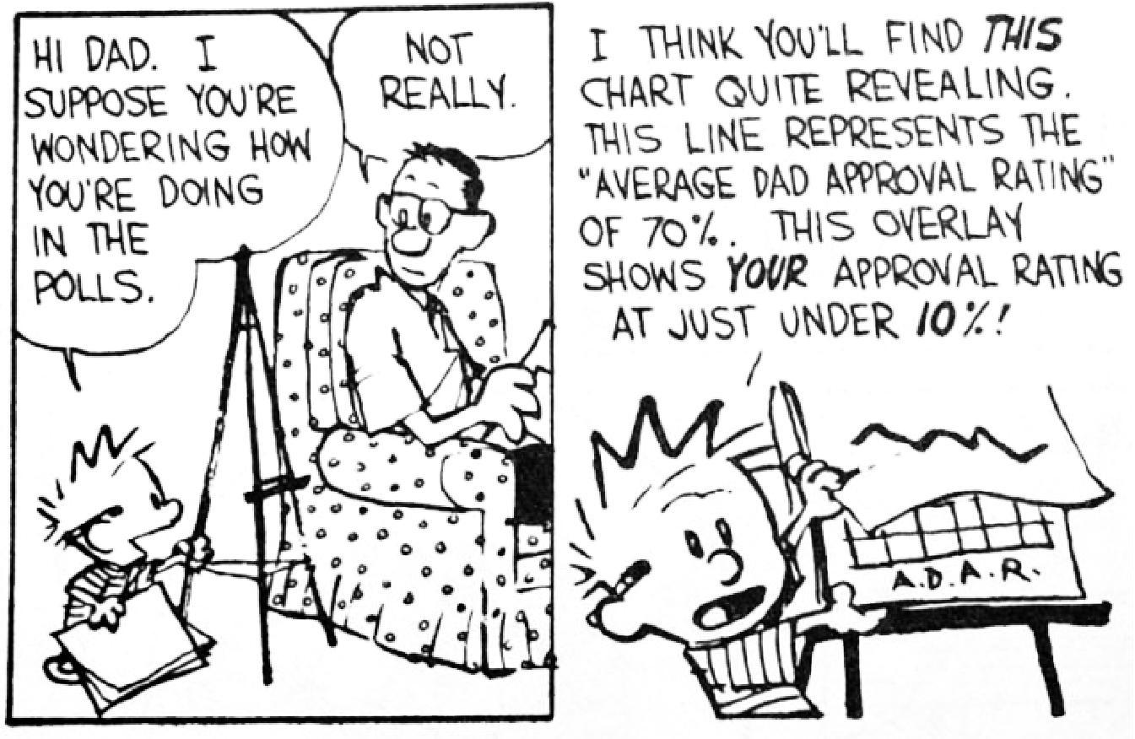
Visual aids
Slides are a common visual aid which:
Summarize the discussion and data
Provide continuous visual support
Have become the de facto standard
© Universal Press Syndicate

Slide 7
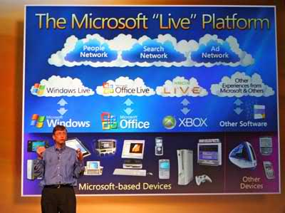
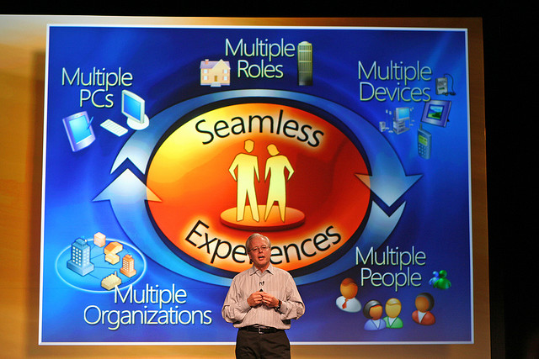
Visual aids
Slides and other visual aids should not:
Become the focus of a presentation
Replace the speaker
Crowded slides may even detract from well organized presentations
niallkennedy Live platform in San Francisco on November 1, 2005

Slide 8
Visual aids
Visual aids
Aspects we will examine include:
Look-and-feel
Textual content
Images
Charts and graphs
Other representations
Presentation software

Slide 9
Look and feel
Visual aids
The format of slides should aid in presenting the material
The format of the slide should not attract attention
The format should not change from slide-to-slide
The overall format is commonly referred to as the look-and-feel of the presentation

Slide 10
Look and feel
Visual aids
Four aspects regarding the look-and-feel:
Consistency
Color scheme
Slide background
“Someone Else’s Slides” syndrome

Slide 11
Consistency
Visual aids
– Look and feel
The appearance of slides should not change from slide-to-slide
The audience will learn where to look

Slide 12


On technical presentations
Consistency
The appearance of slides should not change from slide-to-slide
The audience will learn where to look
Less time will be spent navigating the format
Inconsistencies can be frustrating if they are significant…
http://www.peoplequake.com/

Slide 13
Consistency
Consistency
Consistency
Visual aids
– Look and feel
Small changes will distract the audience
Movement attracts the eye
Survival mechanism
Small changes will distract the audience
Movement attracts the eye
Survival mechanism
Small changes will distract the audience
Movement attracts the eye
Survival mechanism
Small changes
Annoy the audience
Appear unprofessional
Small changes
Annoy the audience
Appear unprofessional
Quickly flip through the slides to detect small changes

Slide 14
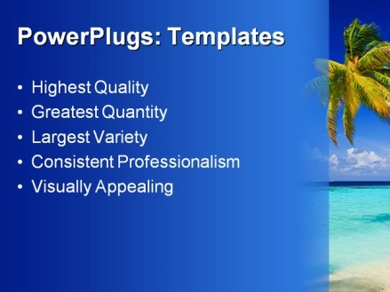

Color schemes
Visual aids
– Look and feel
Background images distract and potentially clash
A plain background is most appropriate for technical presentations
Dark text on a white or light background is common
http://www.crystalgraphics.com

Slide 15
Color schemes
On technical presentations
14
Visual aids
– Look and feel
Background images distract and potentially clash
A plain background is most appropriate for technical presentations
Dark text on a white or light background is common
Some people prefer yellow on blue
Anecdotal evidence suggests light-on-dark is better in larger rooms
http://www.crystalgraphics.com

Slide 16
Color schemes
On technical presentations
15
Visual aids
– Look and feel
Background images distract and potentially clash
A plain background is most appropriate for technical presentations
Dark text on a white or light background is common
Some people prefer yellow on blue
Anecdotal evidence suggests light-on-dark is better in larger rooms
Avoid red-green and other clashing colors
http://www.crystalgraphics.com

Slide 17
Color schemes
On technical presentations
16
Visual aids
– Look and feel
Background images distract and potentially clash
A plain background is most appropriate for technical presentations
Dark text on a white or light background is common
Some people prefer yellow on blue
Anecdotal evidence suggests light-on-dark is better in larger rooms
Avoid red-green and other clashing colors
Warm colors tend to agitate audiences
http://www.crystalgraphics.com

Slide 18
Backgrounds
This speaker’s backgrounds are white with accents at the top

Slide 19

Backgrounds
This speaker’s backgrounds are white with accents at the top
Non-uniform backgrounds can cause issues
The title font color literally blends in
This background ships with PowerPoint

Slide 20
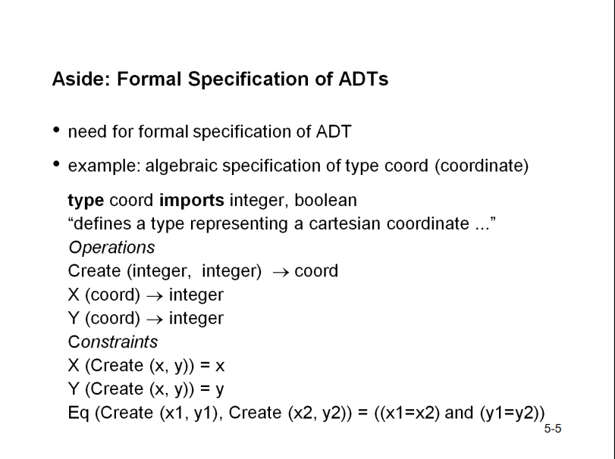
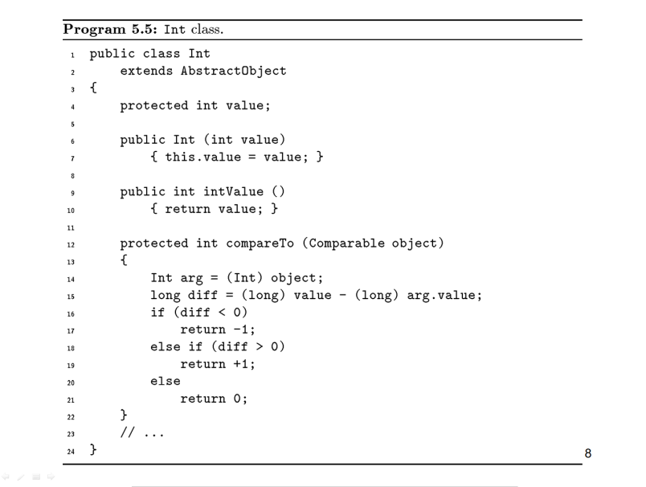
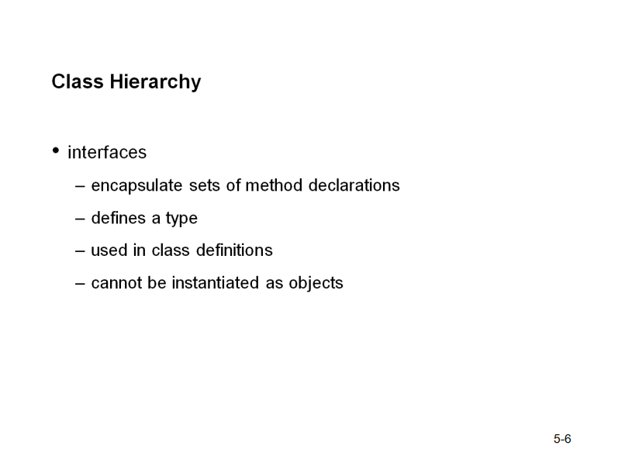
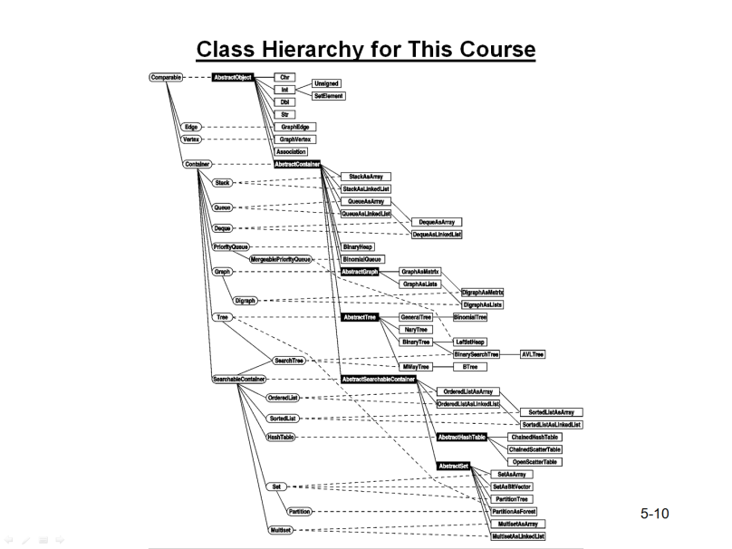
“Someone Else’s Slides”
Visual aids
– Look and feel
Don’t fall victim to “someone else’s slides” syndrome, it reduces
Your preparation time
The time you spend thinking about the presentation
B. Priess

Slide 21

“Someone Else’s Slides”
Visual aids
– Look and feel
Most importantly, you should avoid
Plagiarism
http://methodwithmadness.blogspot.ca/2012/08/is-plagiarism-hampering-development-of.html

Slide 22
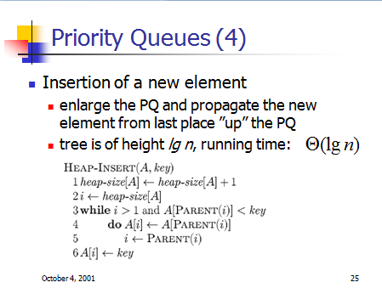
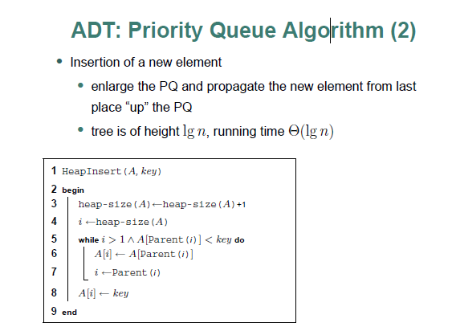
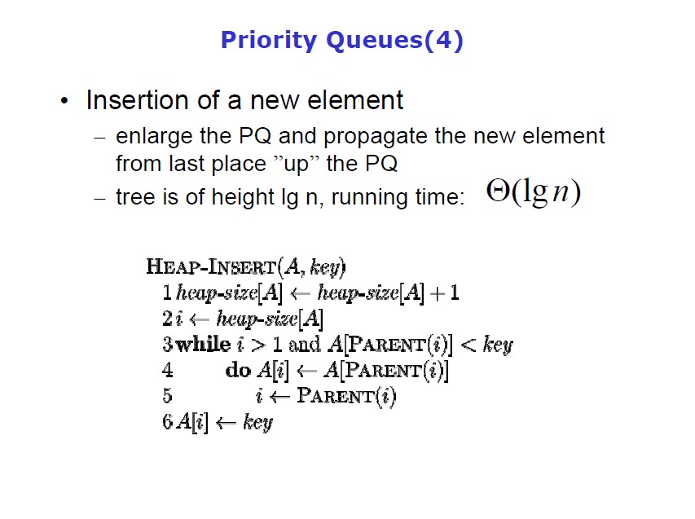
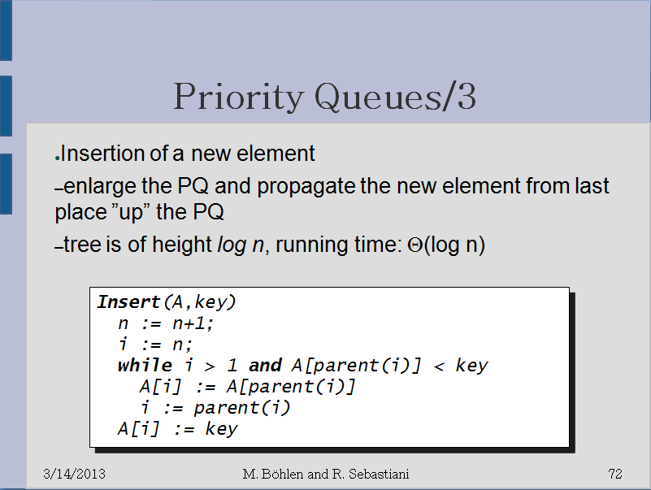
“Someone Else’s Slides”
Visual aids
– Look and feel
It is unfortunately common practice to copy slides, often with little or no form of attribution
Copyists make small cosmetic changes
ght lg n, run
ght lg n, run
ght log n, run
ght lg n, run
Original: Simonas Šaltenis

Slide 23
Textual content
Visual aids
A significant amount of information is carried by text
Aspects concerning text:
Layout
Typeface
Font size
Language

Slide 24
Layout
Visual aids
– Textual content
Text should be laid out hierarchically
Linear text lack association
Audience will look at each point separately
PowerPoint has some nice features
It allows indentation
Text can appear progressively

Slide 25
Layout
Visual aids
– Textual content
Text should be laid out hierarchically
Linear text lack association
Audience will look at each point separately
PowerPoint has some nice features
It allows indentation
Text can appear progressively
Do not, however
Use excessive
And unnecessary
And pointless hierarchical indentation
Two levels at most
In contrast to the previous slide...

Slide 26
A slide presenting information about the foam that hit Columbia
Review of Test Data Indicates Conservatism for Tile
Penetration
The existing SOFI on tile test data used to create Crater was reviewed along with STS-87 Southwest Research data
Crater overpredicted penetration of tile coating significantly
Initial penetration to described by normal velocity
Varies with volume/mass of projectile (e.g., 200ft/sec for 3cu.in)
Significant energy is required for the softer SOFI particle to penetrate the relatively hard tile coating
Test results do show that it is possible at sufficient mass and velocity
Conversely, once tile is penetrated SOFI can cause significant damage
Minor variation in total energy (above penetration level) can cause significant tile damage
Flight condition is significantly outside of test database
Volume of ramp is 1920cu in vs 3cu in for test
The critical information
2/21/03
6

Slide 27
Layout
Visual aids
– Textual content
Some people advocate using the 1-7-7 rule:
Each slide will cover exactly one point
Each slide has at most seven items
Each item has at most seven words
Do not add unnecessary points and words
Filling up the page is not necessary
After all, it is only a guideline

Slide 28
Layout
Visual aids
– Textual content
Aim for balance
Each page should have approximately the same content

Slide 29
Layout
Visual aids
– Textual content
Avoid having a single word appear on a line as a result of a line wrap
You can either rephrase, shorten, lengthen, or split the line into two items
Otherwise it will look awkward—chances are the line is too long, anyway
This is not the way to do it, people: it will definitely be noticed by the audience
Avoid line wraps with only one or two words
Rephrase, shorten, lengthen, or split it
It looks awkward—the line is probably too long
This will be noticed by the audience

Slide 30


On technical presentations
Layout
Visual aids: Look and feel
Too many “features” alienate your audience
You focus on the glitz
The presentation suffers...
FAIL!
http://sonoranalliance.com/

Slide 31
Typeface
Visual aids
– Textual content
The selection of typeface is important
The slides must be read from a distance
Use a sans serif typeface with a uniform nib
P P
Better for poster
and on-screen text
Better for printed text

Slide 32

Typeface
Visual aids
– Textual content
Sans serif examples:
Arial abcdefghijklmnopqrstuvwxyz
Trebuchet abcdefghijklmnopqrstuvwxyz
Calibri abcdefghijklmnopqrstuvwxyz
Fonts with serifs may work as titles, but are harder to read:
Georgia abcdefghijklmnopqrstuvwxyz
Constantina abcdefghijklmnopqrstuvwxyz
Times New Roman abcdefghijklmnopqrstuvwxyz
Avoid
Broadway
Museo
Comic Sans
Courier New

Slide 33
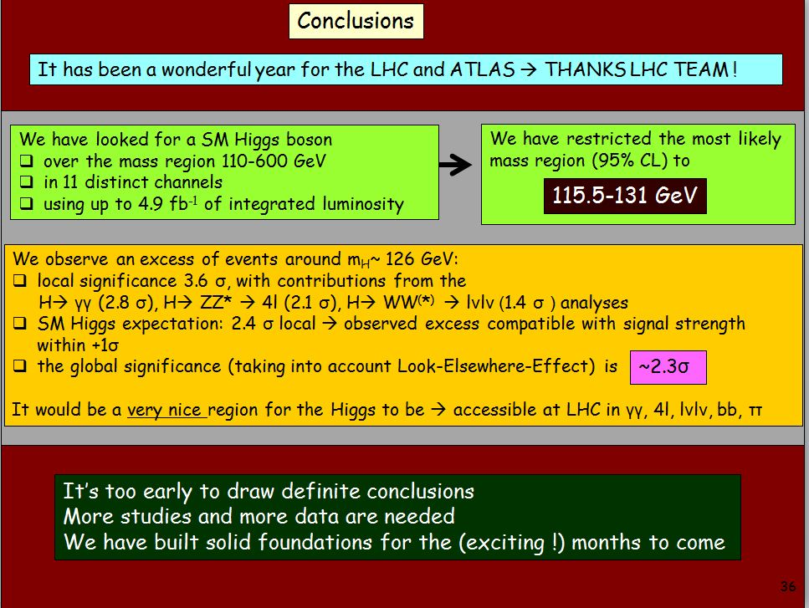
Typeface
Visual aids
– Textual content
“Using Comic Sans (except in comic strips) is like doing physics in Imperial units.” Alastair Houghton
Fabiola Gianotti (CERN)

Slide 34
Font
Visual aids
– Textual content
Use a reasonable sized font
This will prevent you from crowding your slides
20 pt
18 pt
A large font is annoying and fills up too much of the space available on the slide
A small font is almost impossible to read, especially for those people in the back who are squinting their eyes trying to figure out what is the $#!+ it is that you have on the slide.
Additionally, at this point, no one is listening to me and is instead desperately trying to figure out what it is that is written here. After all, it must be very important. Like I mentioned elsewhere, the slides should complement your talk, not replace it.
This is a 12 pt font which is great for normal text, but it is grossly inadequate for a talk.
As there are members of the audience who are slightly older than you (here, your evaluators, in the real world, your managers and vice presidents). They would like to see your slides, too.
Too much information on the slide

Slide 35
Language
Visual aids
– Textual content
Use correct grammar and spelling
Each speling or gramatical mistake is a distraction
Such errors will appear very unprofessonal
If yew sea read underliming, cheque it
Reread your slides after 48 hours
You must understand English grammar too abbreviate it

Slide 36


Observations
Visual aids
– Textual content
A few final observations:
In general, use American spellings
English is not everyone’s first language
Use conventional capitalization
WE ARE NOT USED TO READING IN ALL CAPITAL LETTERS
It’s Also More Difficult To Read When The First Letters Are All Capitalized
Avoid underling, boldface, and exclamation marks!

Slide 37

Images
Visual aids
A picture is worth a thousand words
Use them as they will
Convey more information than text
They’re more memorable
Bad pictures are memorable, too
We will look at:
Use
Formats
Image tools

Slide 38
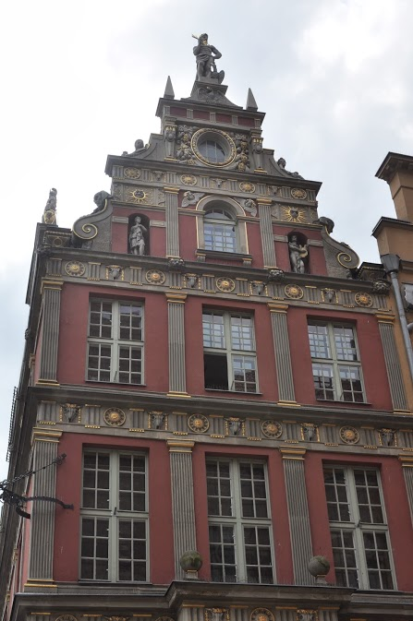


Spacing
Visual aids
– Images
Don’t crowd images
Each image should be surrounded by both an
appropriate and bal-
anced amount of white- space

Slide 39


Spacing
Visual aids
– Images
Don’t crowd images
Whitespace allows the audience to focus on the individual images or graphs

Slide 40
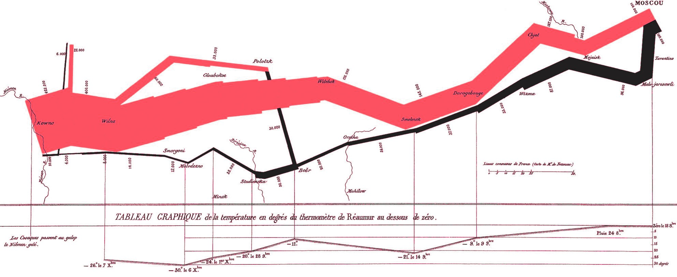
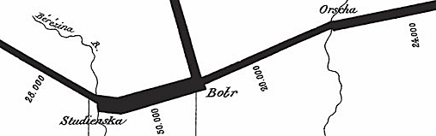
Use
Visual aids
– Images
This classic by Minard shows Napoleon’s advance on Moscow
The path he took
The number of surviving soldiers
The effect of river crossings is clear
The temperature during the retreat
Reference your images…
145,000
400,000
24,000
4,000
Charles Minard, French Invasion of Russia, 1869

Slide 41














Use
Visual aids
– Images
Do not use images gratuitously—especially clipart
http://office.microsoft.com

Slide 42
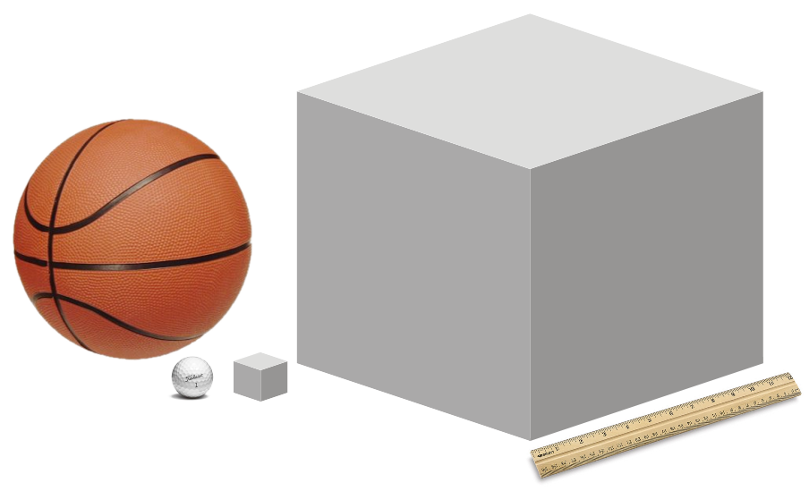

Use
Visual aids
– Images
Consider the Orbiter being hit by the foam during launch
The simulations with a 3 cubic inch object predicted no damage
Unfortunately, the foam that hit the space shuttle was 1920 cubic inches
www.titleist.com
http://www.acmeunited.com/
Michael Alley

Slide 43
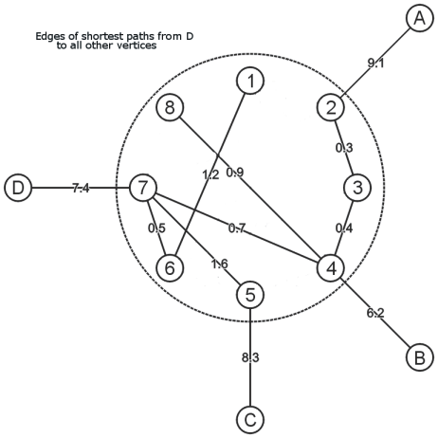
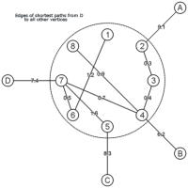

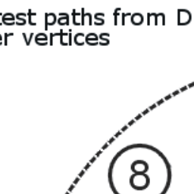
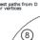
Use
Visual aids
– Images
Don’t blow up small images:
Compare
Imagine showing this image?
1200 × 1200
zoomed 200 × 200

Slide 44
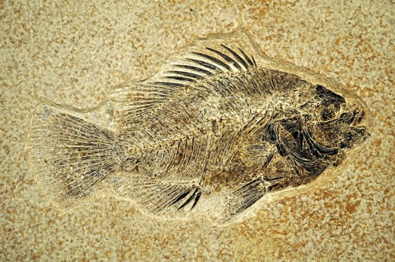
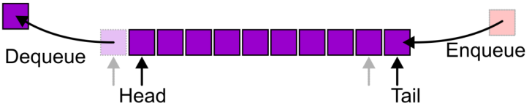
Formats
Visual aids
– Images
Two types of images:
Photographs
Graphics and line drawings
Image formats include:
JPEG/JPG
PNG
GIF

Slide 45
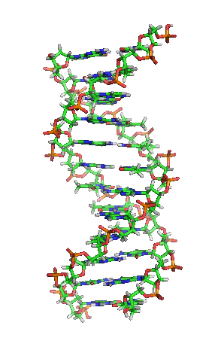

Formats
Visual aids
– Images
JPEG: Joint Photographic Expert Group
Use with Photographs
PNG: Portable Network Graphics
Use with graphics and line drawings
GIF: Graphics Interchange Format
Don’t use it
unless you need an animation
http://courses.bio.unc.edu/2011Fall/Biol202Section7/

Slide 46
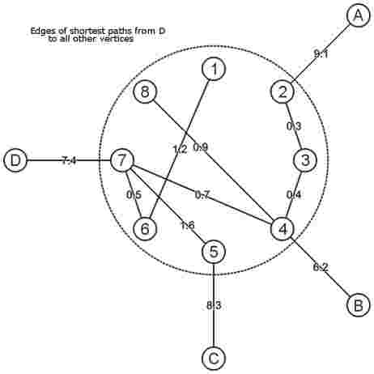
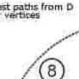
Formats
Visual aids
– Images
Comparing PNG and JPEG with graphics

Slide 47
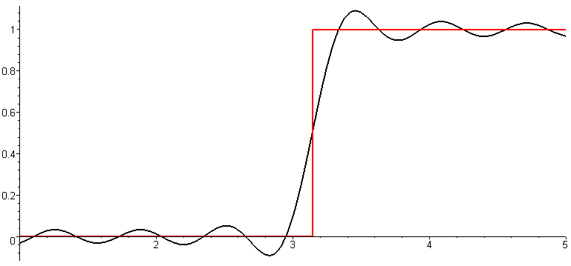
Formats
Visual aids
– Images
The waves are truncated Fourier series (MATH 211)
Sharp transitions are smoothed
Transients appear as speckles
Unit step function
Fourier approximation

Slide 48
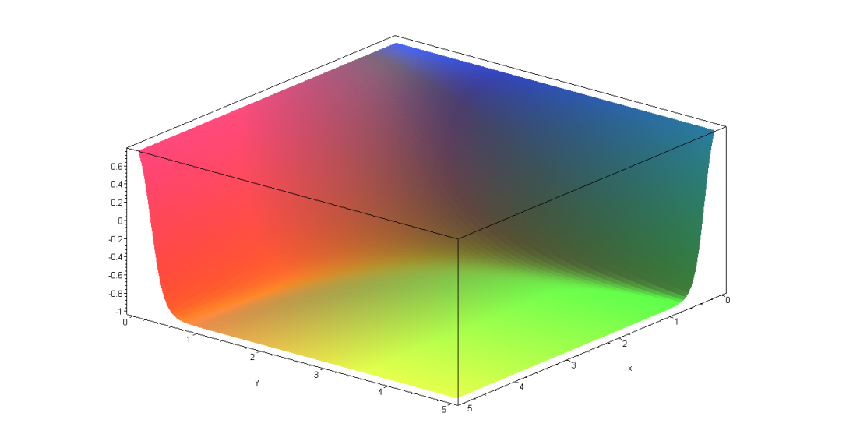



Formats
Visual aids
– Images
Comparing 24-bit PNG and 8-bit dithered GIF

Slide 49
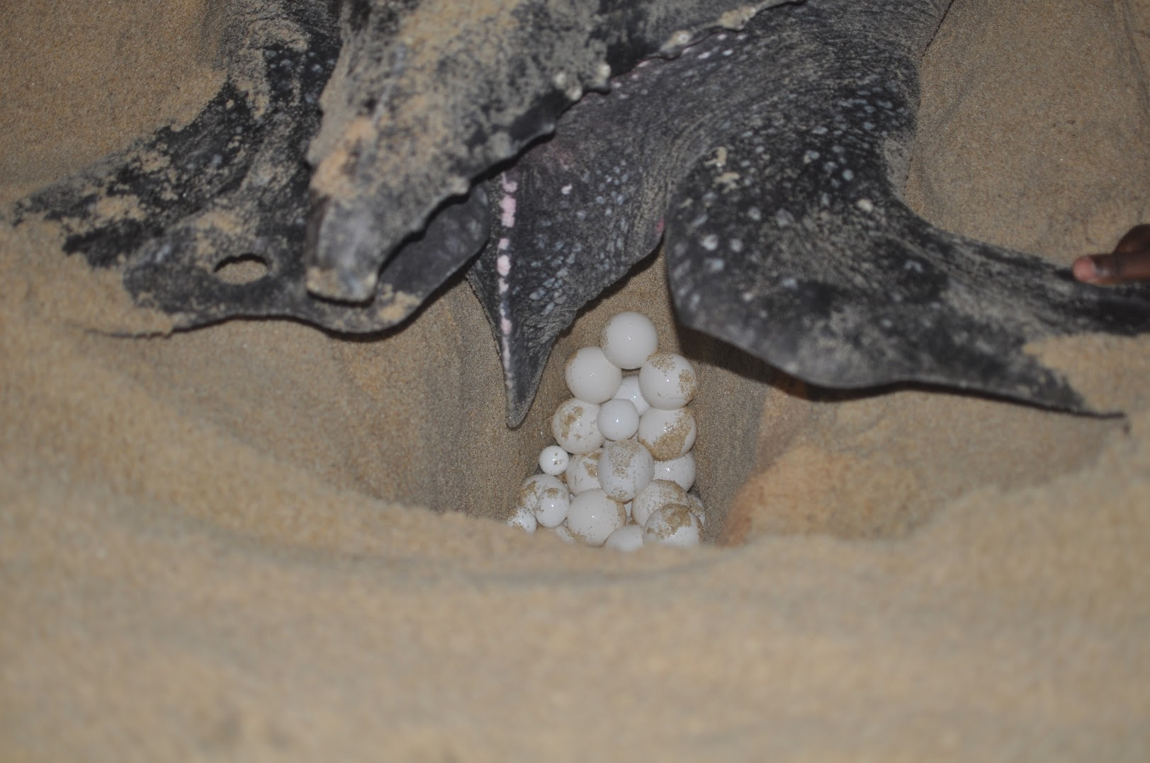
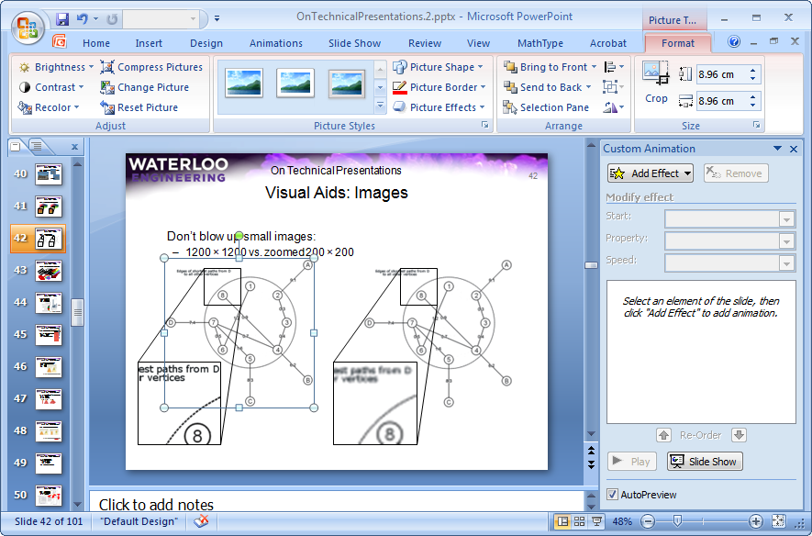

Tools
Visual aids
– Images
In PowerPoint, you can format images with Picture Tools
Avoid Picture Styles
Adjust the brightness and contrast
Crop the image
For example:

Slide 50
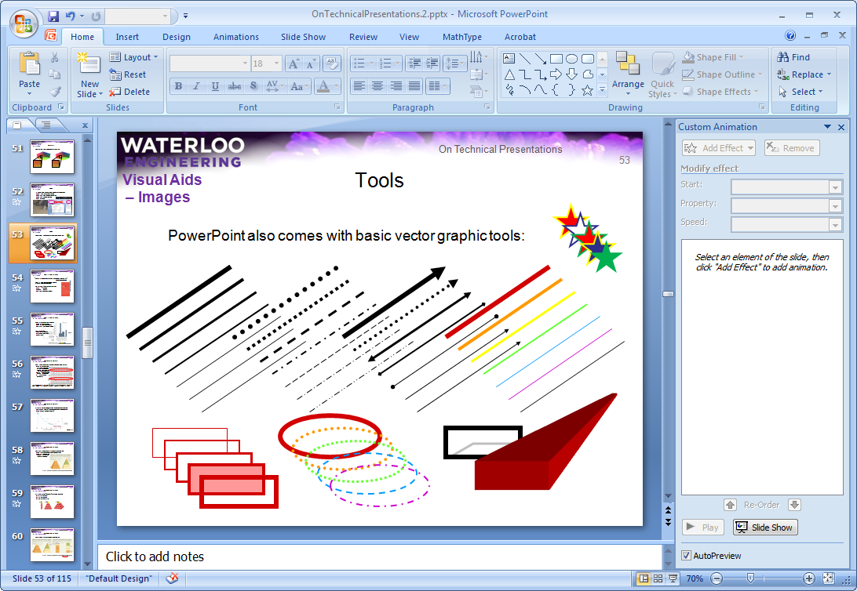
Tools
Visual aids
– Images
PowerPoint also comes with basic vector graphic tools:

Slide 51

Charts and graphs
Visual aids
“There are three kinds of lies: lies, damned lies, and statistics.”
Prime Minister Benjamin Disraeli
Charts and graphs are wonderful means of presenting data, but be careful!
Darrell Huff's How to Lie with Statistics
Fast: ~100 pages
Cheap: $10-$20
50 years old and still relevant!
http://www.wikipedia.org/

Slide 52
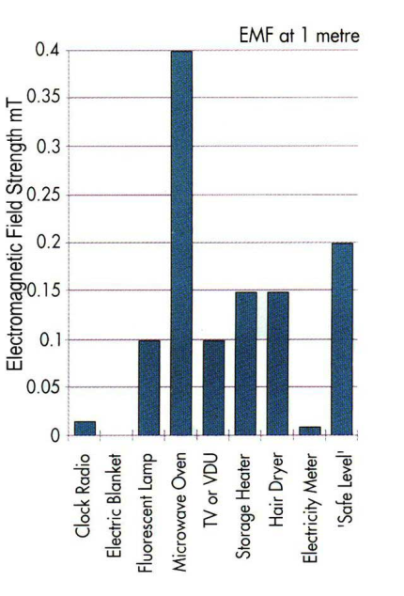
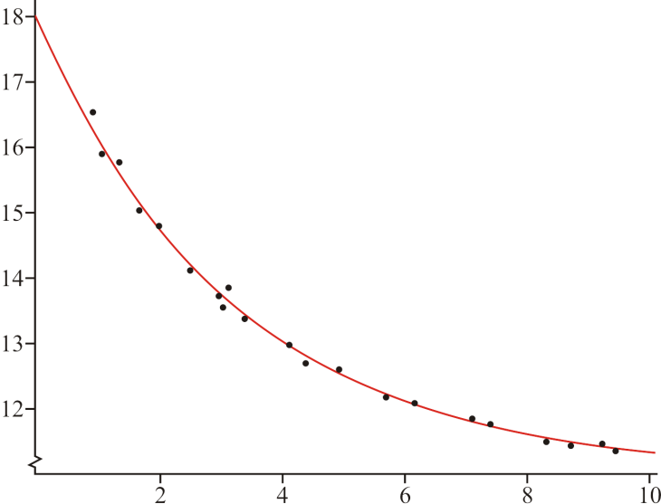
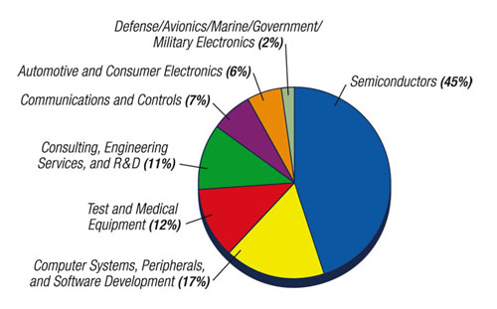
Charts and graphs
Visual aids
– Charts and graphs
They present your data graphically:
Line graphs for trends
Bar graphs for comparisons
Pie charts for crude distributions
We will consider:
Appropriate formats
Manipulating graphs
Chartjunk
www.designcon.com
www.official-documents.gov.uk

Slide 53
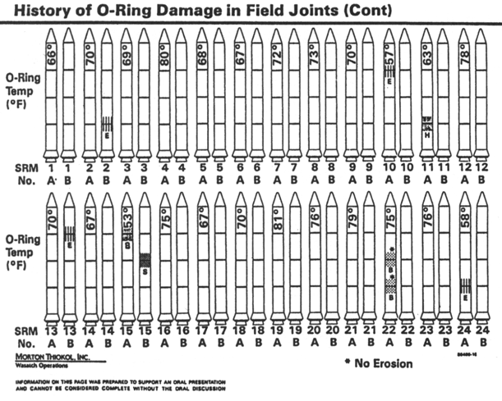
Appropriate format
Visual aids
– Charts and graphs
Don’t show graphs just to have images—the format is critical
This graph was used to show issues with O-ring damage on the Space Shuttle prior to the Challenger launch
Note the location of the launch temperatures
It has a suitable disclaimer
INFORMATION ON THIS PAGE WAS PREPARED TO SUPPORT AN ORAL PRESENTATION AND CANNOT BE CONSIDERED COMPLETE WITHOUT THE ORAL DISCUSSION

Slide 54
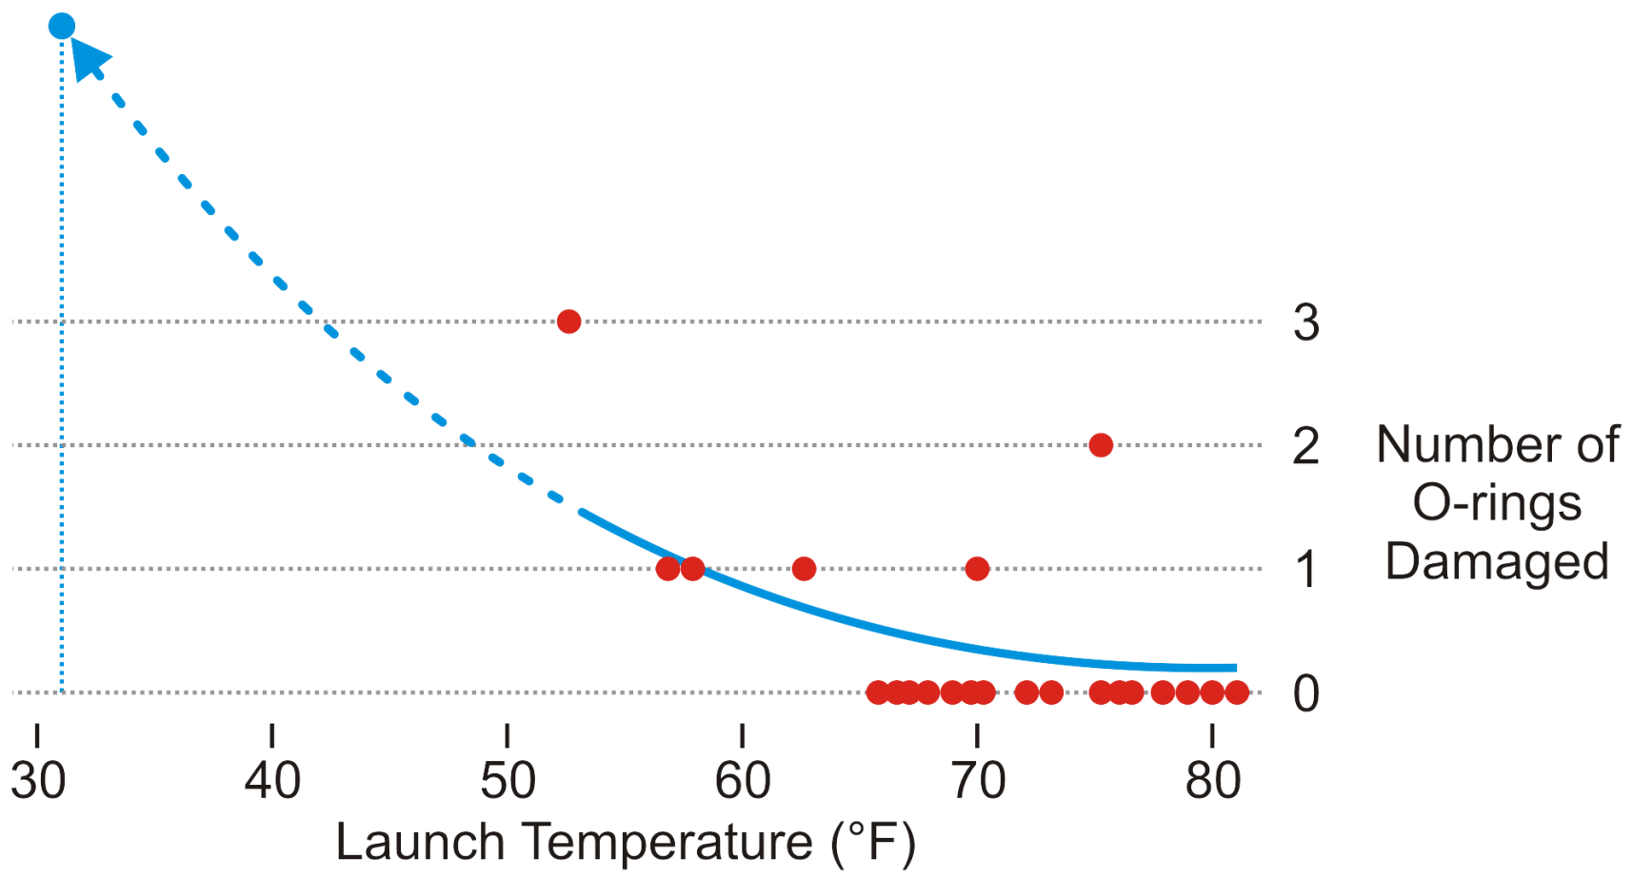
Appropriate format
Visual aids
– Charts and graphs
A more appropriate graph shows temperature versus damage
No launch under 65 °F has not had at least one damaged O-ring
The launch temperature was 31 °F
Edward Tufte

Slide 55
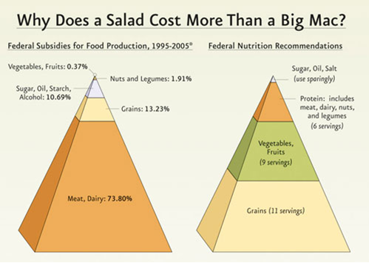
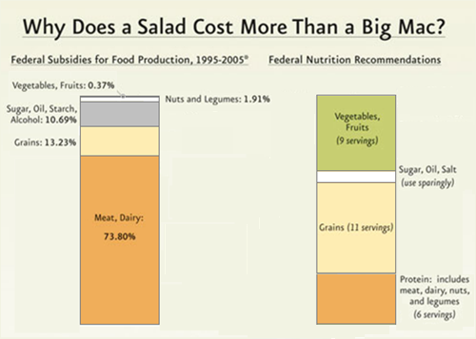
Manipulating graphs
Visual aids
– Charts and graphs
Don’t use images to mislead the audience:
The left shows 1:4 as 1:64
From the PCRM: The Physicians Committee for Responsible (?) Medicine

Slide 56
Chartjunk
Visual aids
– Charts and graphs
Also, always be aware of chartjunk
It would be difficult to allocate more pixels to showing just 12 data points
Yet this is an example of a built-in chart in PowerPoint

Slide 57
Other representations
Visual aids
If you cannot use images or graphs to present your date, consider:
Tables
Mathematics or equations
Source code
Use these sparingly and avoid if possible

Slide 58
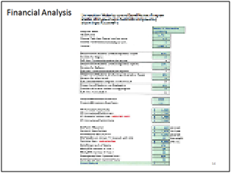
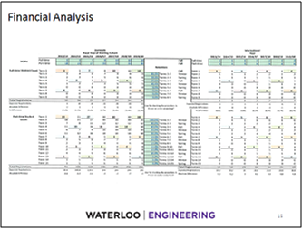
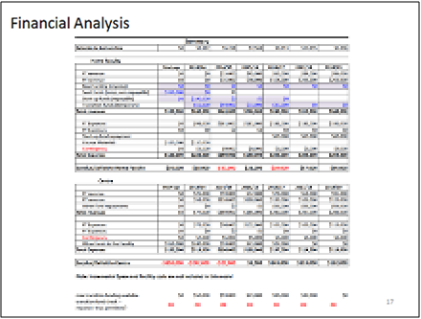
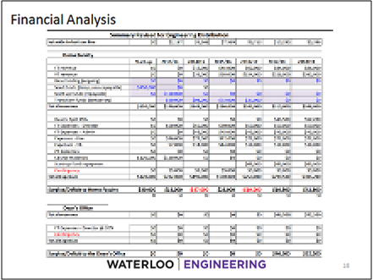
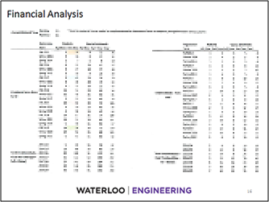
Tables
Visual aids
– Other representations
Raw tables of data will distract and frustrate the audience
Leave such tables for an appendix in a related report
7½ pt font
6 pt font
29 pt font

Slide 59
Tables
Visual aids
– Other representations
For the presentation, determine the essential information
You could show interesting or relevant items
Where possible, use statistics:
If you’re too lazy to find what’s important, why should else should care?
Test | Power Rate [W/s] |  | d_{p}10³ [V] | C [A] | AT [s]
 | W_{p} | W_{a}
2 | 435 | 860 | 0.840 | 0.10 | 5.84
15 | 1157 | 925 | 4.000 | 0.65 | 0.13
Category | Mass Rate [W/s]
 | W_{p} | W_{a}
Small | 430 ± 30 | 8.8 ± 0.6
Large | 1140 ± 40 | 9.1 ± 0.8

Slide 60
Tables
Visual aids
– Other representations
If you include a table, minimize the PowerPoint “features”
This table has a lot of chartjunk
Element | Atomic Number | Atomic Mass | State at STP | Filling Orbital | Element category
Hydrogen | 1 | 1.00794(7) g/mol | gas | 1s¹ | nonmetal
Helium | 2 | 4.002602(2) g/mol | gas | 1s² | noble gases
Lithium | 3 | 6.941(2) g/mol | solid | 2s¹ | alkali metal
Beryllium | 4 | 9.012182(3) g/mol | solid | 2s² | alkaline earth metal
Boron | 5 | 10.811(7) g/mol | solid | 1p¹ | metalloid
Carbon | 6 | 12.0107 g/mol | solid | 1p² | nonmetal
Gold | 79 | 196.966569(4) g/mol | solid | 6s¹ | metal

Slide 61
Tables
Visual aids
– Other representations
Use proper alignment and minimize unnecessary chartjunk
Units
Element | Atomic Number | Atomic Mass (g/mol) | State at STP | Filling Orbital | Element Category
Hydrogen | 1 | 1. 00794(7) | gas | 1s¹ | nonmetal
Helium | 2 | 4.002602(2) | gas | 1s² | noble gases
Lithium | 3 | 6.941(2) | solid | 2s¹ | alkali metal
Beryllium | 4 | 9.012182(3) | solid | 2s² | alkaline earth metal
Boron | 5 | 10.811(7) | solid | 1p¹ | metalloid
Carbon | 6 | 12.0107 | solid | 1p² | nonmetal
Gold | 79 | 196.966569(4) | solid | 6s¹ | metal
Element | Atomic Number | Atomic Mass | State at STP | Filling Orbital | Element category
Hydrogen | 1 | 1.00794(7) g/mol | gas | 1s¹ | nonmetal
Helium | 2 | 4.002602(2) g/mol | gas | 1s² | noble gases
Lithium | 3 | 6.941(2) g/mol | solid | 2s¹ | alkali metal
Beryllium | 4 | 9.012182(3) g/mol | solid | 2s² | alkaline earth metal
Boron | 5 | 10.811(7) g/mol | solid | 1p¹ | metalloid
Carbon | 6 | 12.0107 g/mol | solid | 1p² | nonmetal
Gold | 79 | 196.966569(4) g/mol | solid | 6s¹ | metal

Slide 62
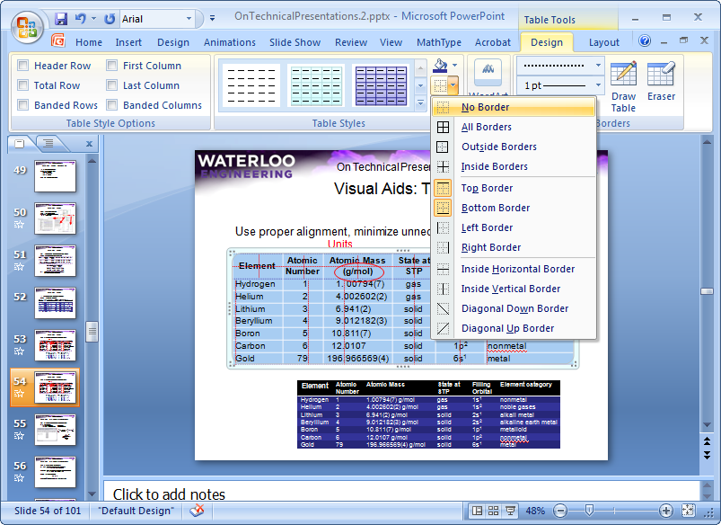
Tables
Visual aids
– Other representations
In PowerPoint, you can format tables
Turn off all Table Style Options
Select all cells of the table and select No Border
Reinsert appropriate borders with the Draw Borders tool

Slide 63
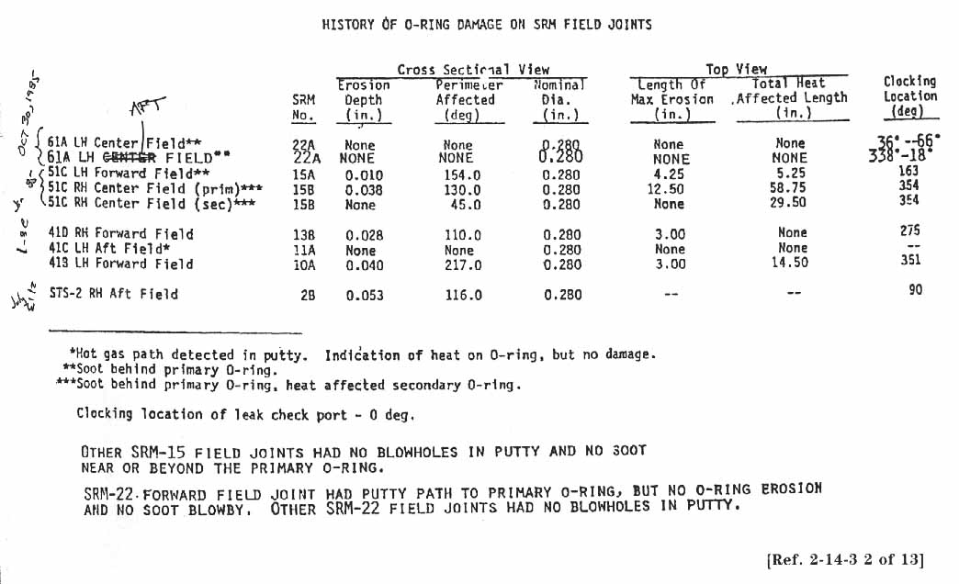
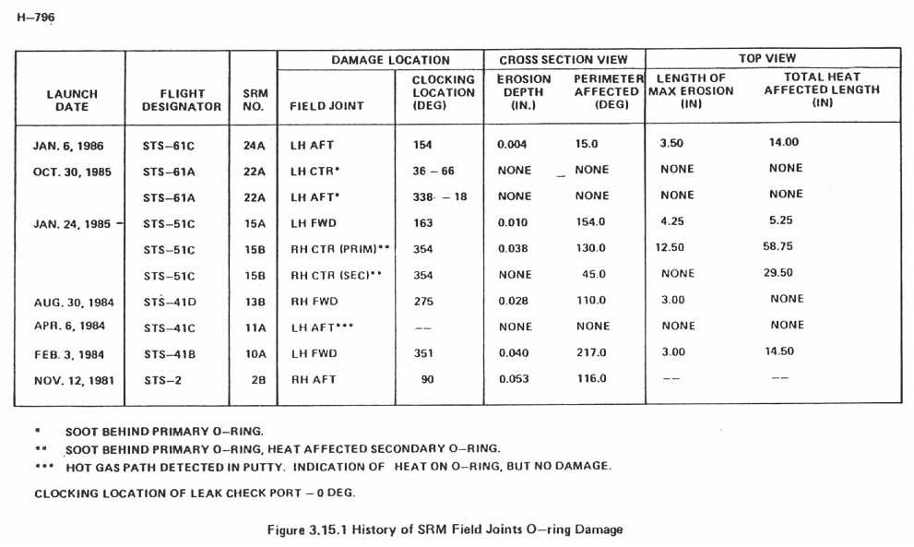
Tables
Even before PowerPoint, it was easy to make bad tables
PowerPoint makes it easier

Slide 64
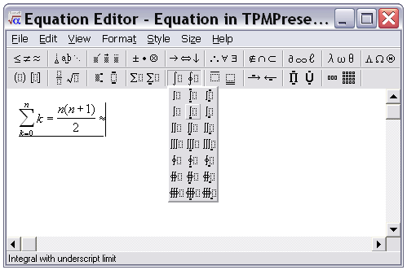
Mathematics
Visual aids
– Other representations
For mathematical expressions, use an equation editor
In PowerPoint
From the menu, select: Insert → Object...
From the dialog box, select: Microsoft Equation 3.0

Slide 65
Mathematics
Visual aids
– Other representations
Use Times New Roman for mathematics
Italics for variables, constants and arbitrary functions
a + b + c + ... + x + y + z + e ^{jπ} + f (g(x))
Roman (upright) for numbers, units, operators and standard functions
3² + 4² = 5² 6 V × 9 C = 54 J sin(x)
Bold for vectors and matrices
Ax = b
Do not use ‘x’ for multiplication, i.e., use 6 × 9 = 42, not 6 x 9 = 54
Symbol typeface

Slide 66
Source code
Visual aids
– Other representations
If you must use source code, use Consolas:
#include <iostream>
using namespace std;
int main() {
for ( int i = 1; i < 500; ++i ) {
cout << "I will NOT throw paper airplanes in class." << endl;
}
return 0;
}

Slide 67


Presentation software
Visual aids
Unless you’re keen, use PowerPoint:
It has many best practices
Be careful...it has many “features”, too
A template is available on the web site
Other presentation software packages are available:
Apple Keynote
OpenOffice.org Impress
Corel Presentations
Beamer for L^{A}T_{E}X
Bring your own computer with an analogue VGA connector/adaptor

Slide 68


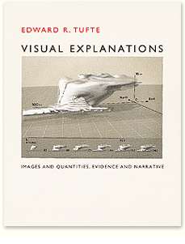
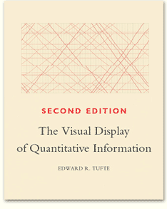
Visual aids
We have covered six aspects of visual aids:
Look and feel
Text
Images
Charts and graphs
Other representations
Presentation software
Consider any publication by Edward Tufte
http://www.edwardtufte.com/

Slide 69
Aspects of good presentations
The slides are ready—now you must present the talk
Interest and knowledge
Organization
Visual aids
Presentation skills
Responding to questions

Slide 70
Presentation skills
Aspects that will affect the speaker’s presentation:
Fear
Composure
Communication
Presentation aids

Slide 71
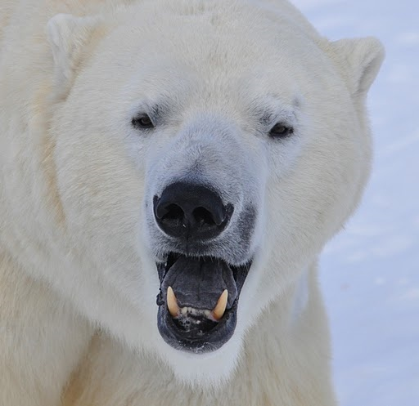
Fear
Presentation skills
Fear:
Increases
Blood flow and rate
Blood-sugar levels
Respiration
Diverts blood to the brain and skeletal muscles
Dilates pupils
Increases perspiration and decreases saliva secretion
Erects hair
Causes faster blood clotting

Slide 72

Fear
Presentation skills
This is a natural animal response
Sometimes termed “fight or flight”
You can harness this energy
Accept that it will happen
Use the extra energy in a positive manner
If fear is attacking you, pause for a few seconds
Sip some water (do not gulp)
http://charuzu.wordpress.com/2009/01/14/the-most-precious-drink-of-all/

Slide 73


Fear
Presentation skills
Steps to avoid nervousness:
Your audience wants you to succeed
Be prepared and practice
Stay within your bounds of knowledge
Focus on the message
Use the properties of fear
Gain experience
Bring a glass of water
Dress up
Ignas Kukenys

Slide 74
Composure
Presentation skills
We will look at four aspects of composure:
Appearance
Stance
Movement
Mannerisms

Slide 75


Appearance
Presentation skills
– Composure
Appearance:
Dress up
If you believe you look good, you will feel good
Consider darker colors and shirts with collars
http://theglasshammer.com/

Slide 76

Stance
Presentation skills
– Composure
Stance:
Stand up straight
Your feet should be shoulder width apart
Have approximately equal weight on both legs
Don’t be too rigid nor too relaxed
http://gawkerassets.com/
http://theglasshammer.com/

Slide 77

Movement
Presentation skills
– Composure
Movement:
Don’t pace back-and-forth
Use movement to indicate a transition
Take two steps left or right when starting a new topic
Act naturally
Empty your pockets of anything that makes noise

Slide 78
Mannerisms/distractions
Presentation skills
– Composure
Mannerisms:
We all have them—most of us don’t notice our own
Get a friend to watch you
Things to watch for:
Hooking fingers in your belt
Standing or holding your head crooked
Odd hand positions
Fiddling with watches, rings or other jewelry
Playing with zippers
Rocking back-and-forth on your feet

Slide 79
Communication
Presentation skills
Five aspects of communication:
Eye contact
Voice
Language
Interaction
Humor

Slide 80

Eye contact
Presentation skills
– Communication
Maintain eye contact with the audience
Avoid looking at your slides or notes, the screen, floor, ceiling, or walls
Make eye contact with each audience member for at least a second
Lack of eye contact suggests lack-of-trust
Do not focus on one individual
Nineteen Eighty-Four, Virgin Films

Slide 81

Eye contact
Presentation skills
– Communication
Maintain eye contact by:
Understanding your talk
Practicing
Having brief slides/notes
Long notes will force you to search through them
Steve Jurvetson

Slide 82
Your voice
Presentation skills
– Communication
You must maintain the interest of your audience with your voice
Your voice must be sufficiently loud for everyone to hear
use a microphone if necessary
A quiet voice implies insecurity or uncertainty
You must speak clearly
Do not slur your words: the audience will focus on your speech, not what you say

Slide 83
Your voice
Presentation skills
– Communication
Your voice and speech has a number of characteristics which you can change, including:
Volume
Increase for emphasis, decrease for subtleties
Pace
160 words per minute—quicken for emphasis
Tone
Monotonic voices put readers to sleep
Inflection
Accents and emphasis will focus the audience

Slide 84
Language
Presentation skills
– Communication
The language you use should be professional…
Okay?
Umm....
Absolutely not!
Definitely!
despite the fact that...
Foobar
We will utilize ...
Well, ...
man-made
It is a definite fact, ...
..., you know?
Like, ...
I mean, ...
manpower
in light of the fact that...
Randi Speaks, Skeptics Guide to the Universe, Episode 181.

Slide 85
Language
Presentation skills
– Communication
The language you use should be professional…
Avoid fillers, jargon, colloquialisms, slang, swearing, gender-specific or verbose language
Okay?
Umm....
Absolutely not!
Definitely!
No.
despite the fact that...
Foobar
because...
Yes.
synthetic
We will utilize ...
Well, ...
man-made
use
It is a definite fact, ...
..., you know?
Like, ...
I mean, ...
human resources
manpower
in light of the fact that...
because

Slide 86
Language
Presentation skills
– Communication
Just avoid noisy pauses and fillers…
Instead, a silent pause will not even be noticed by the audience
Okay!!!
Okay?
Okay!
Okay?
Okay?
Okay?
Okay?
Okay?
Okay?
Okay?!
Okay?
Okay!!!
Okay?
Okay?
Okay?
Okay?!
Okay?
Okay!!!
Okay!!!

Slide 87
Interaction
Presentation skills
– Communication
As part of your interaction, try making a personal connection
What makes you, personally, interested in the subject matter?
Can you convey that enthusiasm to the audience?
Do you want to interact with the audience?
This depends on the audience:
If significant amounts of new material are being presented, delay any discussions to the end
If the audience is acquainted and informed, you can engage in a discussion if the subject matter is relevant
Your technical presentations will not have audience interaction

Slide 88



Humor
Presentation skills
– Communication
Humor should be used sparingly
Our attention begins to drop after 15-20 minutes
Humor forms a distraction that can reset the brain
The audience can listen for another 15-20 minutes
The shorter and more critical the presentation, the more careful you must be when inserting humor
Be natural
Say something you think is funny
Some people just can’t tell jokes… don’t worry about it
Ricardo Liberato
Blackadder, BBC1
© Pan Books

Slide 89
Presentation aids
Presentation skills
Presentation aids can significantly help
We will consider:
Wireless remotes
Laser pointers
Using presenter view
Built-in links

Slide 90


Wireless remotes
Presentation skills
– Presentation aids
Imagine Al Gore running back and forth to the computer to hit the space bar in An Inconvenient Truth
Fortunately, we provide you with a wireless remote
An Inconvenient Truth
www.logitech.com

Slide 91

Laser pointers
On technical presentations
Presentation skills
– Presentation aids
A few words on laser pointers:
Use them sparingly
People will play karaoke with the laser pointer
Honest, your audience isn’t stupid
If you’ve read one point
They’ll probably figure out that you’re going to the next
One presenter left the laser on for a full 20-minute talk
http://laser.ankaka.com/

Slide 92


Laser pointers
Presentation skills
– Presentation aids
Use the pointer to indicate details which you cannot easily describe
User:C J Cowie
Xilinx Inc.

Slide 93


Presenter view
Presentation skills
– Presentation aids
Normally, your presentation is on a separate screen
The default is to view the presentation on both screens
Selecting Use Presenter View under Slide Show→Monitors shows your notes as well as surrounding slides
ensceptico
Erlend Aakre
Intel Free Press
http://www.audiovisualsales.com.au/

Slide 94
Presentation skills
We have covered four aspects of presentation skills:
Fear
Composure
Communication
Presentation aids

Slide 95
Aspects of Good Presentations
You have now finished the presentation—you must now respond to questions from the audience:
Interest and knowledge
Organization
Visual aids
Presentation skills
Responding to questions

Slide 96

Responding to questions
You finish your presentation
You say “Are there any questions?”
The timer stops
You’re under 15 minutes
The audience may now ask you questions:
“the presentation after the presentation”
We will consider:
Getting ready
What to do
What not to do
No answer?
Don’t be a dick
Welcome Back, Kotter
Warner Bros. Television Distribution

Slide 97
Getting Ready
Responding to questions
Following any technical presentation is an opportunity for the audience to ask questions
This is the last (and most lasting) impression the audience will have
While preparing your talk, anticipate possible questions
If possible, prepare additional slides for anticipated questions!
Such slides would go into further depth than what was discussed
If you don’t use them, it will benefit your talk never-the-less

Slide 98
What to do
Responding to questions
When answering questions:
Repeat the question
This makes sure you heard the correct question
The audience may not have heard the question
It gives you time to think about an answer
Ensure you understand the question
If necessary, ask for clarification
Take a moment to think about your answer

Slide 99
What not to do
Responding to questions
Do not:
Evaluate questions: “Great question!”
Lie or make-up an answer
Answer a similar—but easier—question
Talk around or ignore the question
Talk as if you’ve answered the question
These will negatively impact your talk
One foolish answer will make the audience question everything
The inequality:
10 h work + 15 min presentation + 1 stupid answer < 0

Slide 100

No answer?
Responding to questions
Valid non-answers (to at least some questions) are:
“I don’t know”, or
“I don’t know, but I’ll get back to you”
but do get back to that person (credibility)...
Hedge your answers if necessary:
“I may be wrong, but...”
“It is my understanding that...”

Slide 101

Don’t be a dick
Responding to questions
Not all questions are valid:
A question may be outside the scope of the presentation
The TPM sessions are not a forum to demonstrate your superior intellect by crushing the speaker
© Paramount Pictures

Slide 102

Aspects of good presentations
We’ve covered five aspects of giving good technical presentations:
Interest and knowledge
Organization
Visual aids
Presentation skills
Responding to questions
Mastering these skills takes time and practice....
http://digitaljournal.com/article/295809

Slide 103

Failing your proficiency examination
Sew, you gave you’re presenting, butt yew
Forgot
Used
wrote down everything you wanted to say on your slides and then sat there and read them to the audience, keeping your back to them while you drawl on...
did not practice
Waited until two days before the talk to start thinking about your topic
picked your nose
Went over time
Printed your work-term report
Lied
and you
Your
slides
the
wrong
font
and
COLOUR

Slide 104
Failing your proficiency examination
If you do not clear the milestone in 2B, you have one second opportunity either:
In 3A, or
In the work-term following 2B
If near Waterloo
If you do not clear with this 2nd attempt, you must take SPCOM 223 or an equivalent course
Attending 12 sessions of Toastmasters gives you another opportunity

Slide 105
Failing your proficiency examination
If you do not show up for your scheduled 2B presentation:
No second opportunity
You must take SPCOM 223 or an equivalent course
Illnesses require a Verification of Illness form with a serious illness
Interviews, in general, do not last three hours:
We will accommodate you—contact the evaluators ASAP
Bring proof of the interview

Slide 106
Failing your proficiency examination
Important points:
2B is likely easier than 3A
It takes 10-15 hours to prepare
A course will require 36 hours plus preparation
Giving the same talk twice will probably result in two fails

Slide 107



Summary
No one is a born public speaker
Walking is intuitive only because you’ve been doing it for 17 years
I’ve made every mistake described in this talk
You can—and will—improve
with effort and practice
clubs.calvin.edu/
User: Zscout370
© 20th Century Fox

Slide 108
Summary
The last talk included:
Interest and knowledge
Organization
In the last hour, we’ve discussed:
Visual aids
Presentation skills
Responding to questions
We concluded with the consequences of failing

Slide 109
Any questions?
A good presentation is a three-act play: a beginning, a middle, and an end
Universities’ Study Transport Group
References
All references are listed on
http://ece.uwaterloo.ca/~tppe000/
http://ece.uwaterloo.ca/~dwharder/TechnicalPresentations/
All unreferenced images are either copyright free or are the work of the author
Some images are published under the GFDL
http://www.gnu.org/copyleft/fdl.html

